Slide 1

Data Structures
Week 11- Graphs
Juan Carlos Pineda
ITESM
juancarlos.pineda@itesm.mx

Slide 2
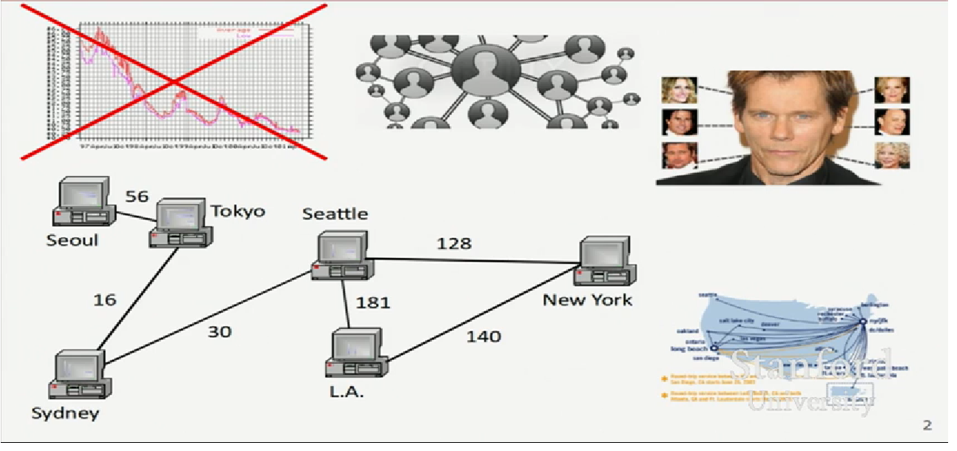
What is a graph

Slide 3
Basic terms
Graph: a data structure containing:
A set of vertices V (also called nodes)
A set of edges E (called arcs)
Which are connections between 2 vertices.
Graph G=(V,E)
An edge is a pair (v, w) where v, w are in V
The graph on the right:
V = { a,b,c,d |
E = {(a,c}, (b,c), (b,d), (c,d) }
Degree: number of edges touching a given vertex
a=1, b=2, c=3, d=2
a
b
c
d

Slide 4
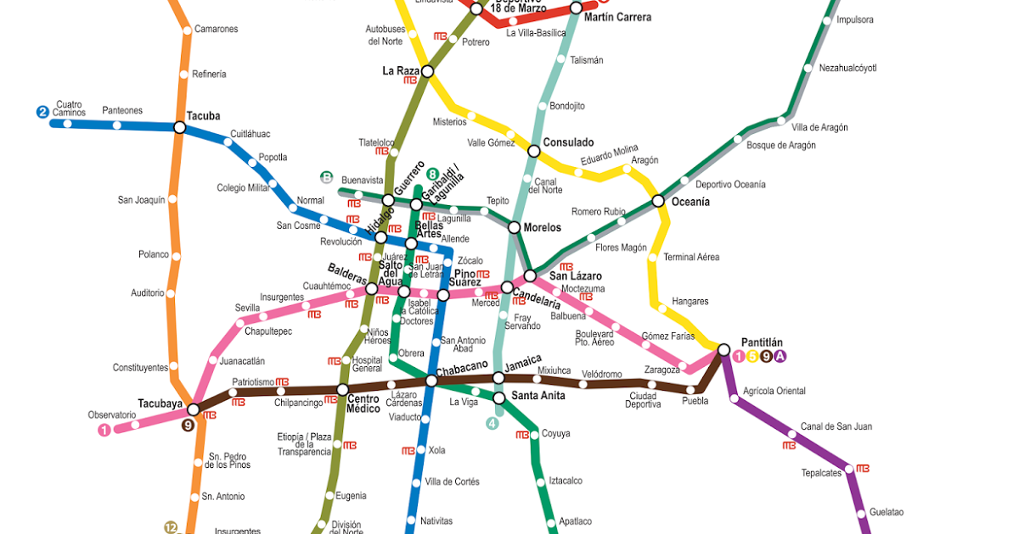
Quick Question
What are the vertices and what are the edges?
Web Pages with links
Functions in a program that call each other
Road maps
Airline routes
Facebook Friends
Paths through a maze

Slide 5
Graphs
Path: a path from a vertex a to b is a sequence of edges that can be followed starting from a to reach b
Can be represented as vertices visited, or edges taken
example , one path from V to Z: {b,h} or {V,X,Z}
What are the two paths from U to Y
Path length: Number of vertices or edges contained in the path
Neighbor or adjacent: Two vertices connected directly by an edge
V
a
b
U
d
X
Z
h
c
c
W
g
Y
f
Notes:
Real life example of this scenario of having shortest path or cheapest path

Slide 6
Reachability
V
Reachable: Vertex a is reachable from b if a path exists from a to b.
Connected: a graph is connected if every vertex is reachable from every other
Complete: if every vertex has a direct edge to every other
a
b
U
d
X
Z
h
c
c
W
g
f
Y
a
b
a
b
d
c
d
c
e

Slide 7
Loops and cycle
V
Cycle: a Path that begins and ends at the same node
Example: {b,g,f,c,a} or {V,X,Y,W,U,V}
Example: {c,d,a} or {U,W, V, U}
Acyclic graph: one that does not contain any cyles
Loop: an edge directly from a node to itself
a
b
U
d
X
Z
h
c
c
W
g
f
Y
Notes:
What edges can we delete to make it acyclic graph

Slide 8
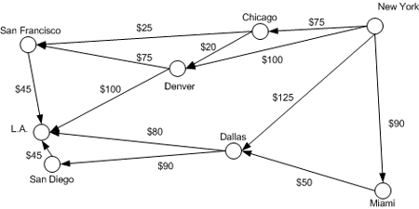
Weighted graphs
Weight: cost associated with a given edge
Some graphs have weighted edges, and some are unweighted
Edges in an unweighted graph can be thought of as having equal weight (e.g. all 0 or all 1, etc)
Example: graph of airline flights, weighted by miles between cities

Slide 9
Directed graph
Directed graph (“digraph”): One where edges are one-way connection between vertices:
If a graph is directed, a vertex has a separate in/out degree
A digraph can be weighted or unweighted
Is the graph below connected? Wy or why not?
a
b
c
d
e
f
Notes:
Example of social networks: Facebook vs twitter

Slide 10
Binary Trees, Linked Lists
A binary tree is a graph with some restrictions:
The tree is an unweighted, directed, acyclic graph (DAG)
Each node’s in-degree is at most 1, and out-degree is at most 2
There is exactly one path from the root to every node
A linked-list is also a graph:
Unweighted DAG
in/out degree of at most 1 for all nodes

Slide 11
Implementing a graph
How is a graph implemented?If we want to make a data structure to represent a graph, what information must we store?
For each vertex? For each edge?
What kinds of questions do we have to answer?
V
a
b
U
d
X
Z
h
c
c
W
g
f
Y

Slide 12
Edge list
Edge list: an unordered list of all edges in the graph
An array, vector or linked list
Each edge structure stores the starting and ending vertex that it connects
The vertices are not explicitly stored anywhere; the set of all vertices is contained implicitly in the list of edges
1
2
3
6
4
5
0 | 1 | 2 | 3 | 4 | 5
(1,2) | (1,4) (1,3) | (2,4) | (4,3) | (3,5) | (3,6)

Slide 13
Operations
Which of the following operations is efficient in an edge list?
Finding out if an edge exists from vertex A to B
looping/iterating over all edges
looping/iterating over the neighbors of a given vertex
Finding the degree of a vertex (how many edges tough it)
Printing out a list of all unique vertices in the graph
Using an edge list, how would you find:
All neighbors of a given vertex? The degree of a given vertex?
Whether there is an edge from A to B?
Whether there are any loops (self-edges)?

Slide 14
Adjacency list
Adjacency list: stores edges as lists of each vertex’s neighbors.
Can use a linked list, vector or set
In undirected graphs, edge (i,j) is stored in both i’s and js lists
1
2
3
4
5
6
2
4
7
1
2
3
1
3
5
2
6
4
5
6
1
7
2
6
7
7
3
5
7

Slide 15
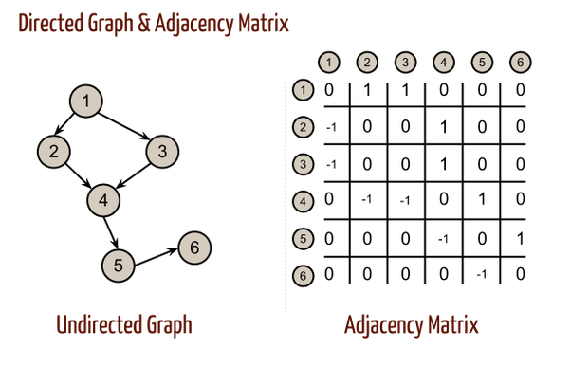
Adjacency matrix
Adjacency matrix: an N x N matrix where
- The entry a [i,j], is the weight of the edge joining vertex i and vertex j (or 0 if no such edge exists)
-In an undirected graph, a[i,j] = a[j,i] for all i, j. (diagonally symmetric)
-In a directed graph, the row represents the start vertex and the column the ending vertex

Slide 16
Weighted/directed graphs
Weighted
-adj. list : store weight in each edge nodes
-adj. Matrix: store weight in each matrix box
Directed
-adj. List: edges appear only in start vertex’ list
Adj matrix: no longer diagonally symetric

